Slide 1
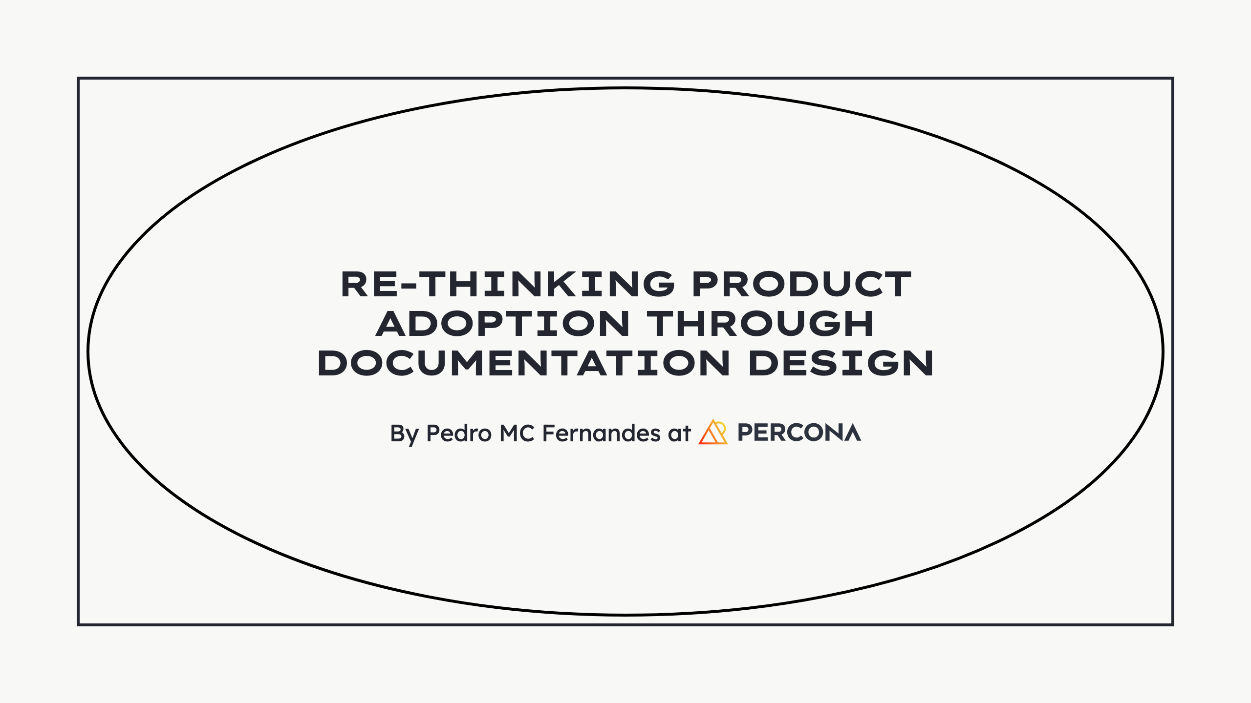
Notes:
- Thank you for the opportunity - Enjoying this design focused event - Hope to be here again next year

Slide 2

Notes:
Who's Pedro? - Lisbon, Portugal - Experience in various industries - Also eCommerce - Designer at Percona - Contributor in FOSS for a long while - Support, translation, some design Alt: Photo of a typical portuguese village street. Very narrow, with cobblestone and white painted houses.

Slide 3

Notes:
Where is this happening? - Born out DB services and consulting - For small, growing and large companies - Later, open-source software - To support services, namely... - Promote freedom to choose Alt: 3 photos of the Percona team at gatherings and events.

Slide 4
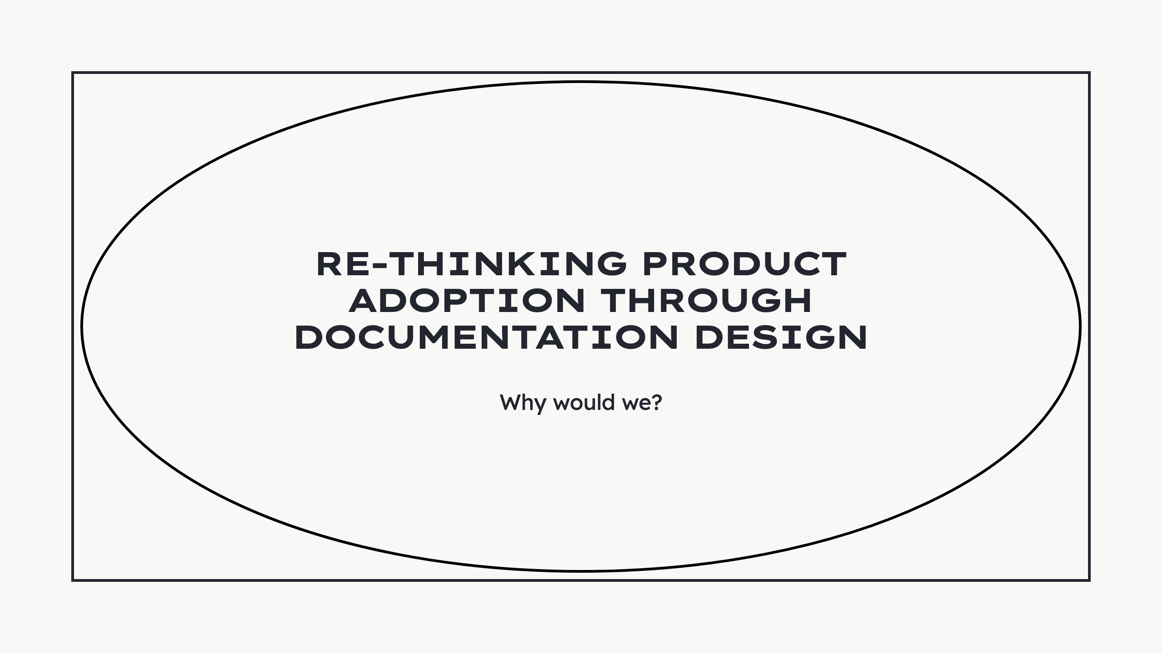
Notes:
Read

Slide 5

Notes:
Here are some of our motivations: - Databases for everyone - Any technical bg - Spark creativity - Help learn - Promote independence - Lower the entry barrier - Reduce effort + time - With this - Better contributions - From anyone to anybody - Optimization of Support - Focus on bigger problem - Societal blockers - Medical industry - Or other sensitive area - Don’t break the bank - Anyone can get in - Regardless of price - Grow at their pace - Scale when ready Alt: Photo of a hairdresser saloon with two people facing each other with, probably, payment devices in front of them as if they are about to process payments with their customers.

Slide 6
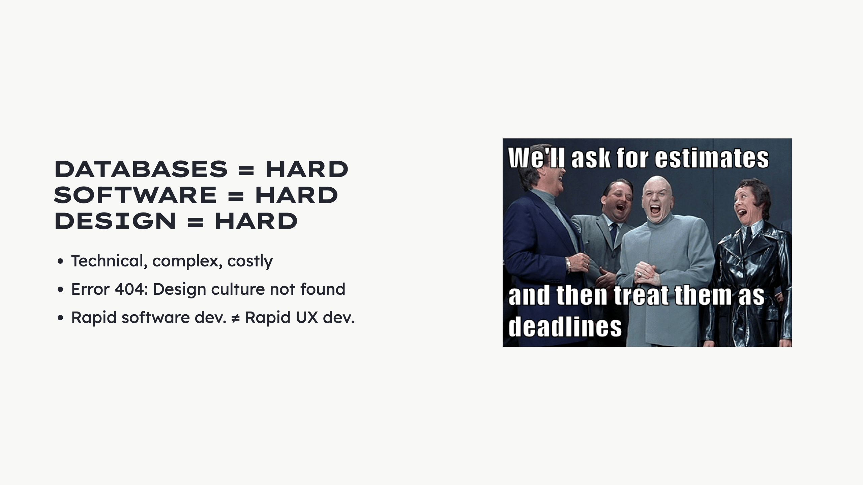
Notes:
Databases: - Technical - Intimidating - Specific terminology - Abstract structures - Lack user centricity Percona: - Wasn't born user-centric - Lack a design culture - Focused on technical solutions - Working/not working things Concurrent rapid development - Software dev + UX dev - Not possible in unprepared teams - Needs deep integration - Team - Processes - More time spent Alt: Image of a meme. It's the Austin Powers movie villains laughing and then overlaid the phrase "We'll ask for estimates and then treat them as dealines"

Slide 7
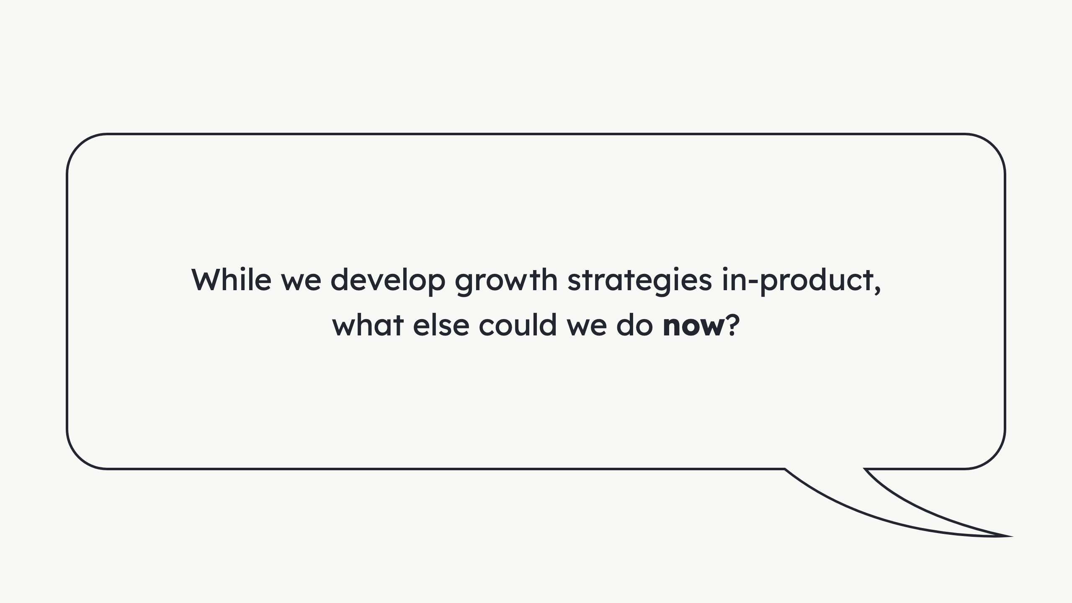
Notes:
Read

Slide 8

Notes:
Ikea Billy bookshelf with Oxberg doors

Slide 9
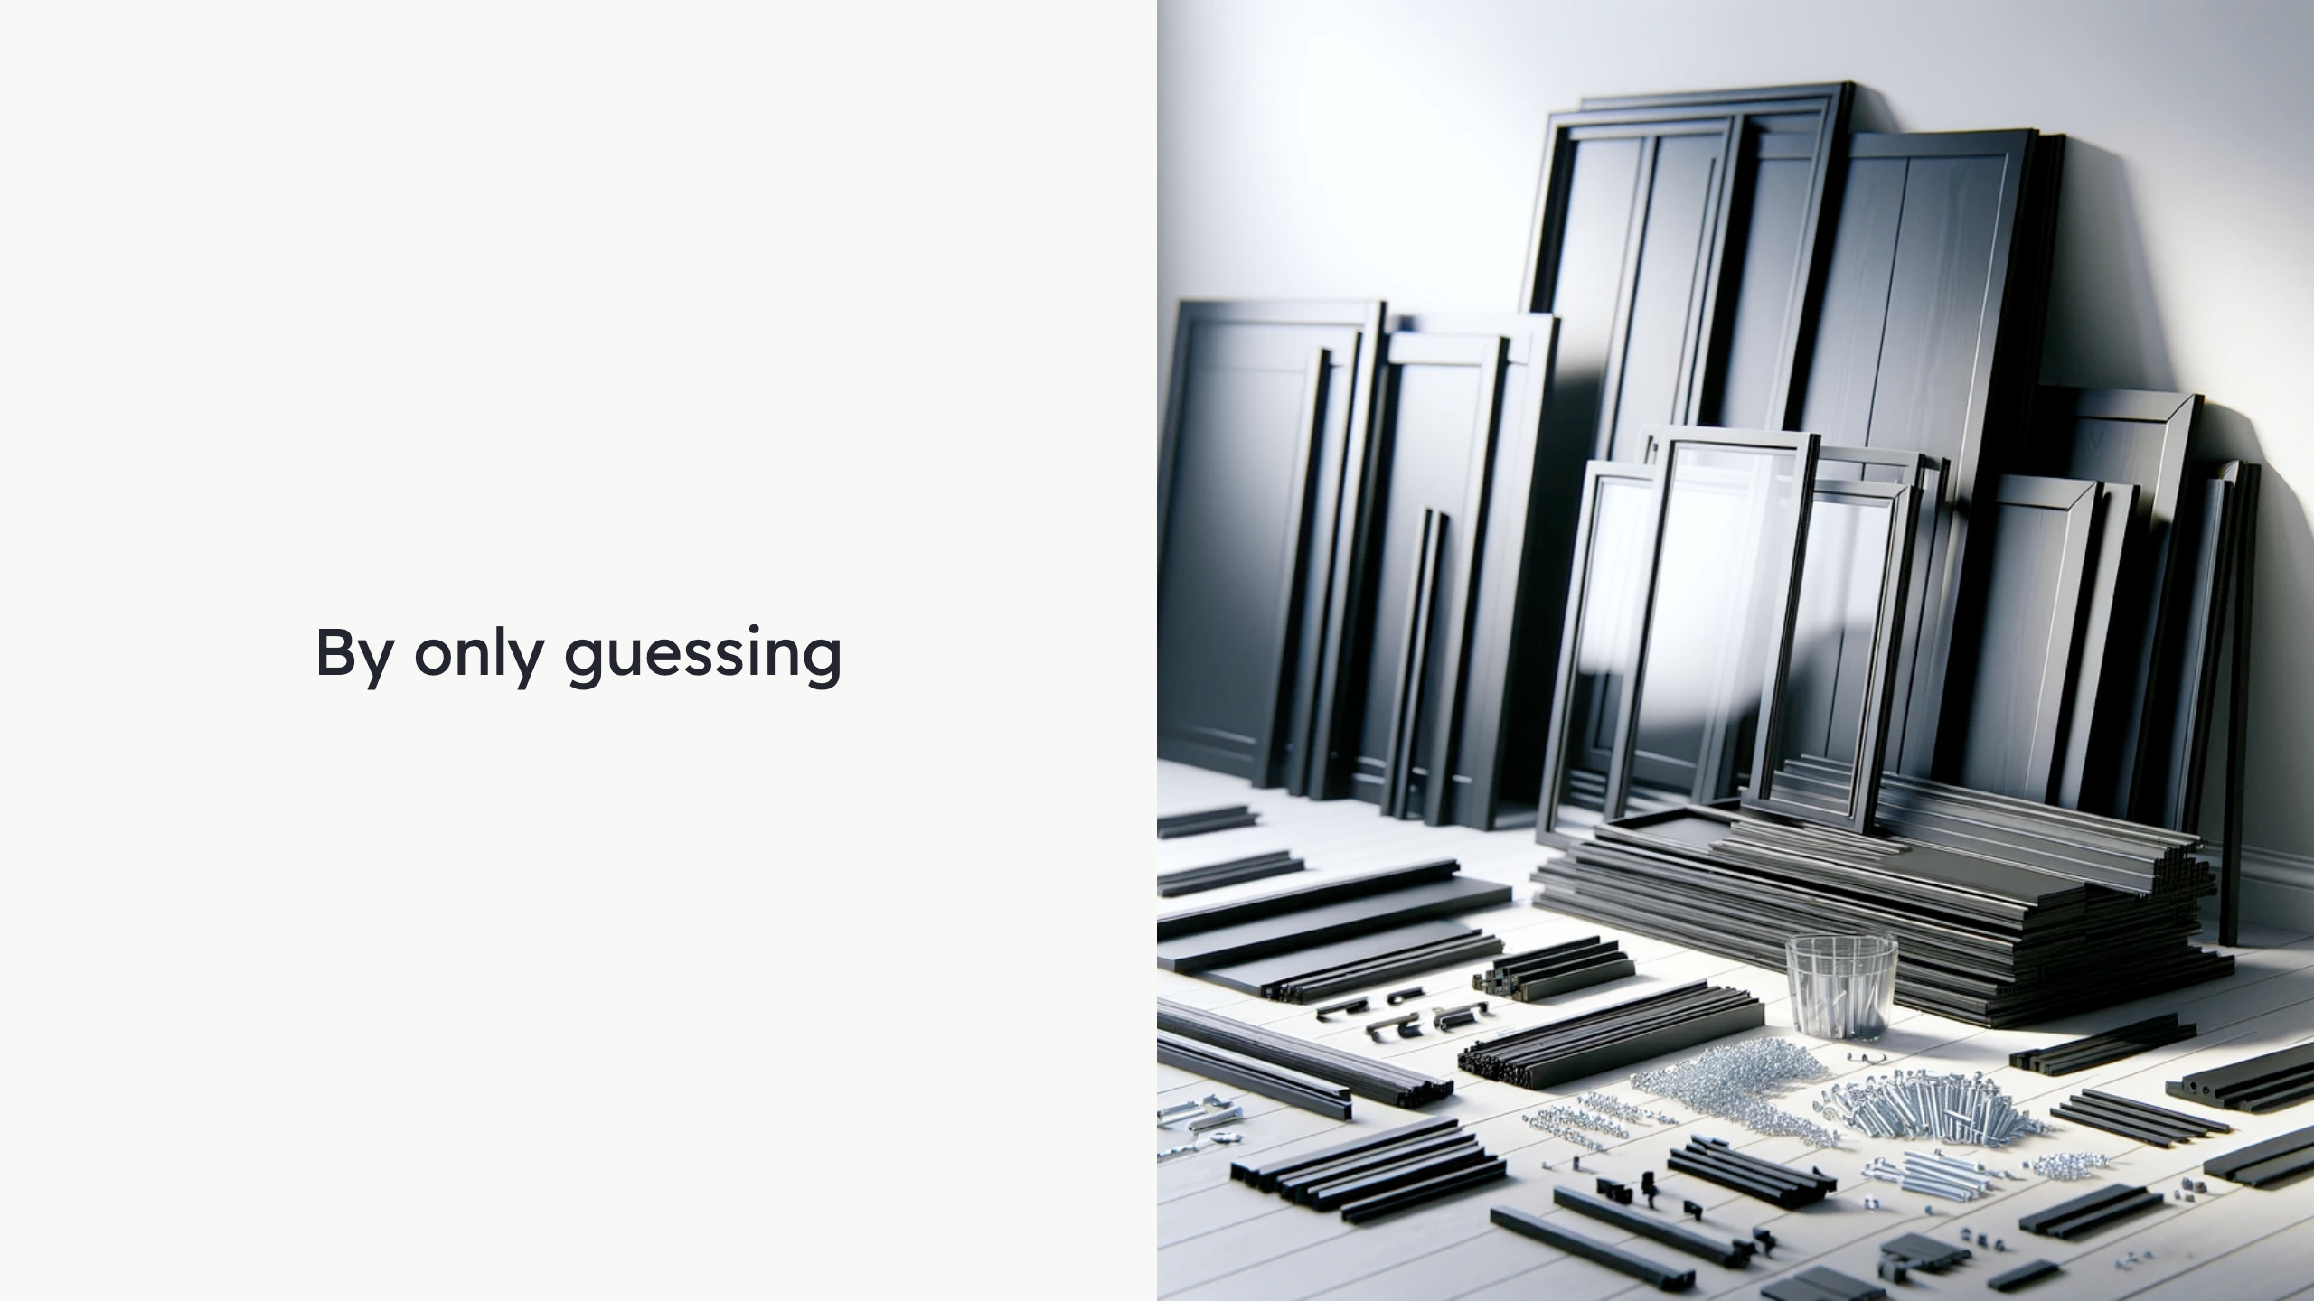
Notes:
... Where each part fits! Alt: AI generated image of a realistic depiction of a lot of furniture pieces, ready to be assembled.

Slide 10

Notes:
- Well designed documentation - Like IKEA's instructions booklet - Errors can still happen - But it improves the experience Alt: Cover of the Ikea Billy instructions booklet.

Slide 11
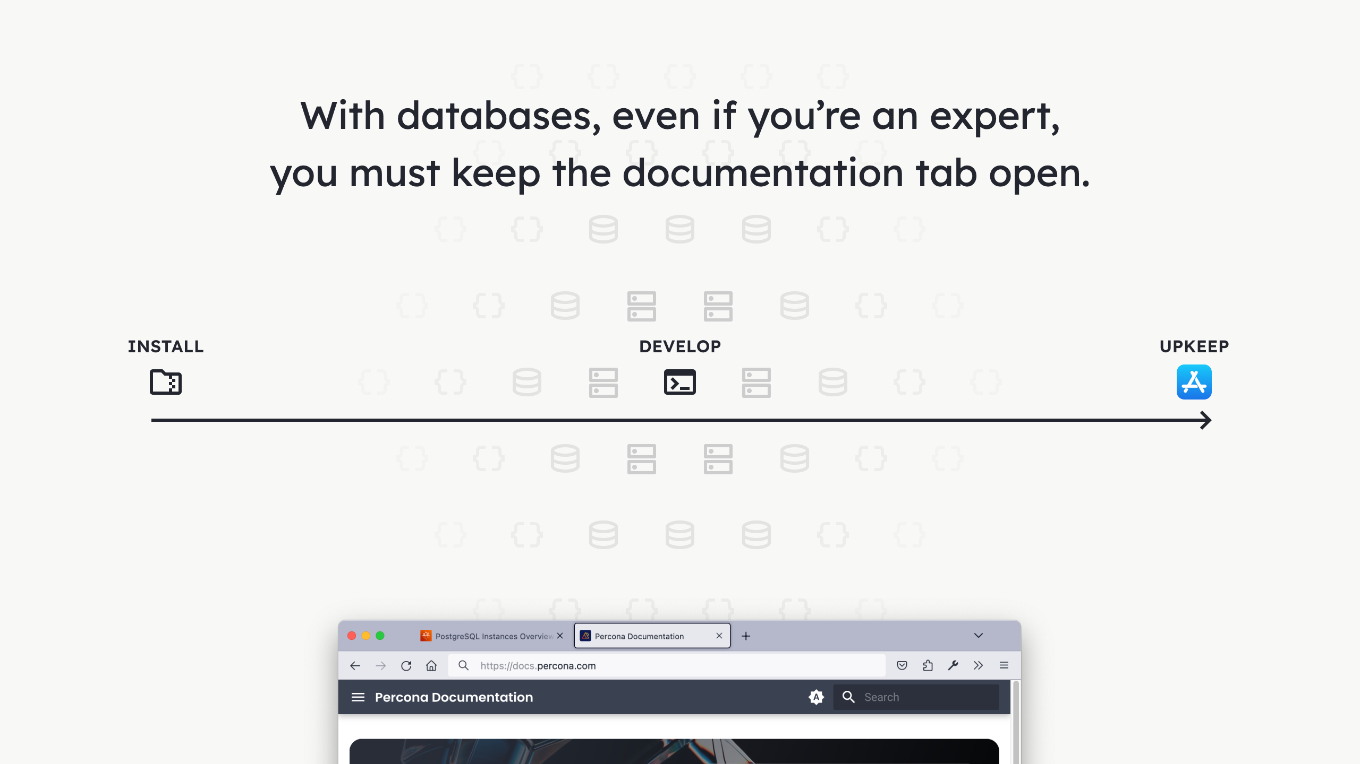
Notes:
Development, management and monitoring of databases: - An entire world - Connections to make - Components to upgrade - Queries to optimize - Security concerns - Performance concerns - And more Alt: Diagram showing the phases of databases use in software developement: installation, development and upkeeping of the application. Below a screenshot detail of the browser tabs showing the documentation open.

Slide 12
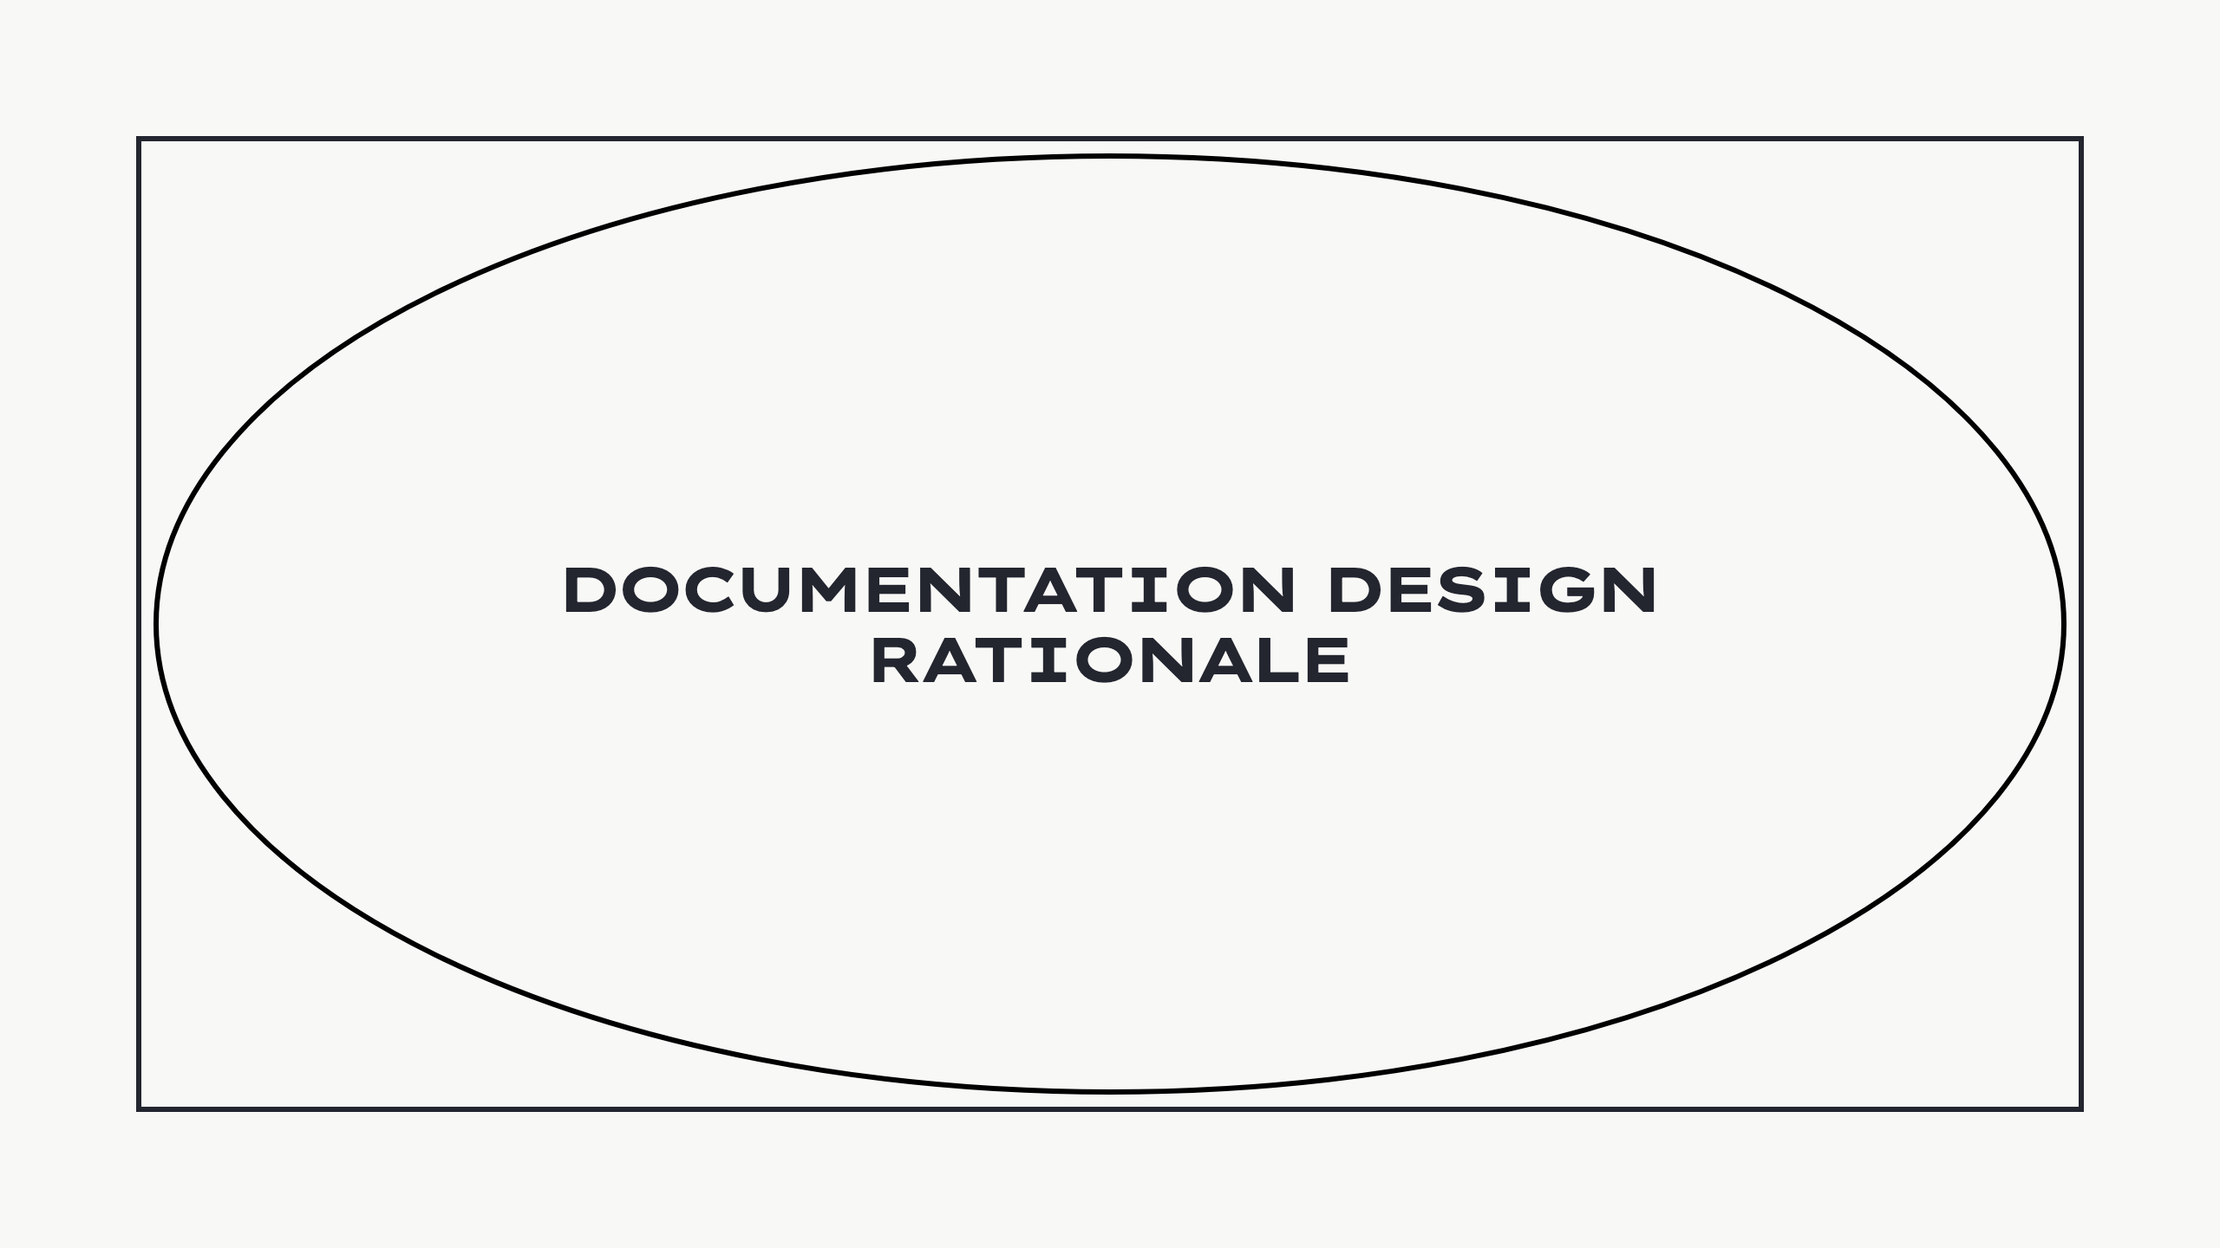
Notes:
- What we did - What we learned - What we think - Open discussion - Spark ideas

Slide 13
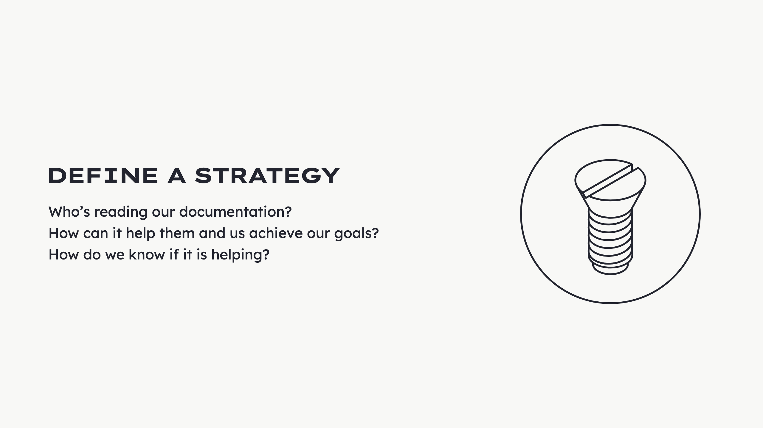
Notes:
Problem: - No strategy in docs - Not an instrument to achieve goals - Just existed... We wanted to change that and ask... Read

Slide 14
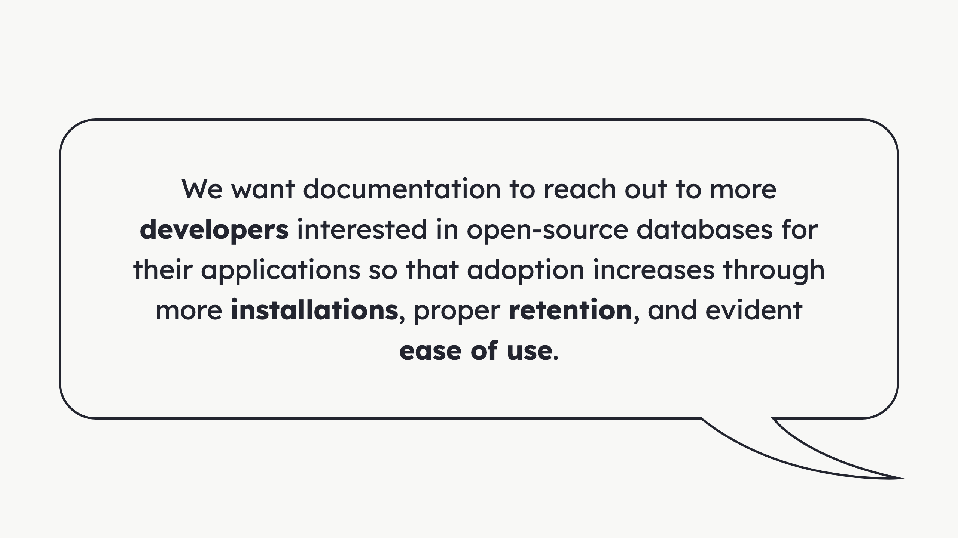
Notes:
You can go deeper, like with: - Identify people and audit accessibility - Set objectives - Define the action scope - Establish the ownership - Set standards - Define tech stack - Pick health metrics - Set feedback streams - Plan maintenance

Slide 15
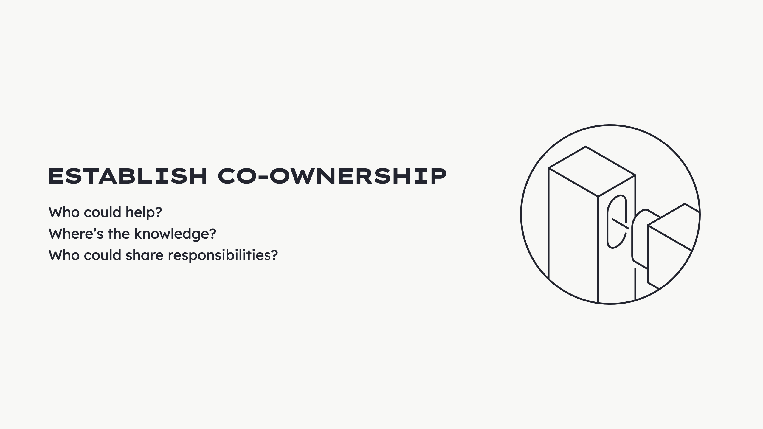
Notes:
Problem: - Documentation just existed - Bare minimum effort to exist in parallel - Had to exist cuz we software house This is not enough. We asked... Read

Slide 16
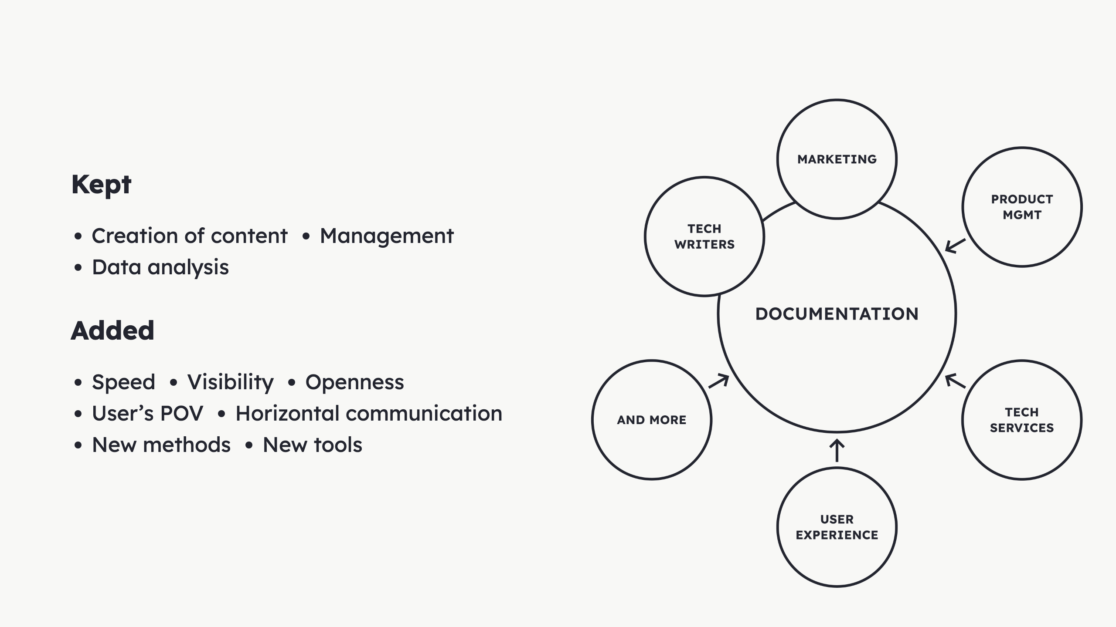
Notes:
Added: - Speed + visibility + openness - More people seeing - Recognizing importance - Incite contribution - We shared all outputs - Brought user representation - Technical Services - Account managers - Customer success - More empirical knowledge - PMs helped - Communicate horizontally - Draw attention - Move things - Garner resources - Product POV - UX team - New ways of doing - Problem-solving techniques - Propose solutions - Explored new tools - Posthog Alt: Diagram of the various departments that were already working on the documentation and the other departments that were invited into it to add expertise.

Slide 17
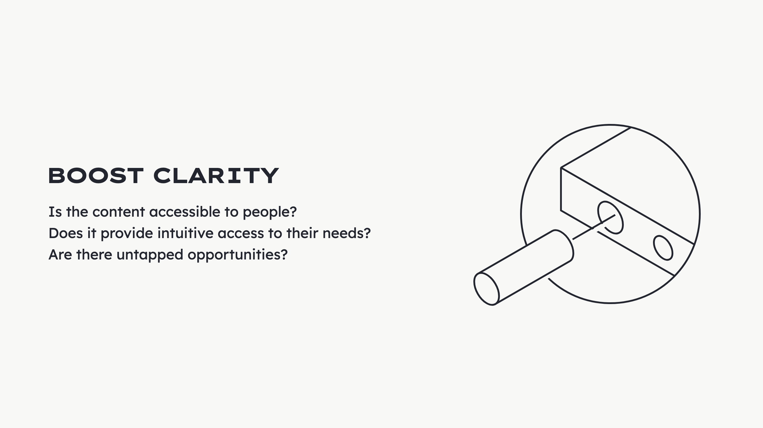
Notes:
We wanted to ask... Read

Slide 18
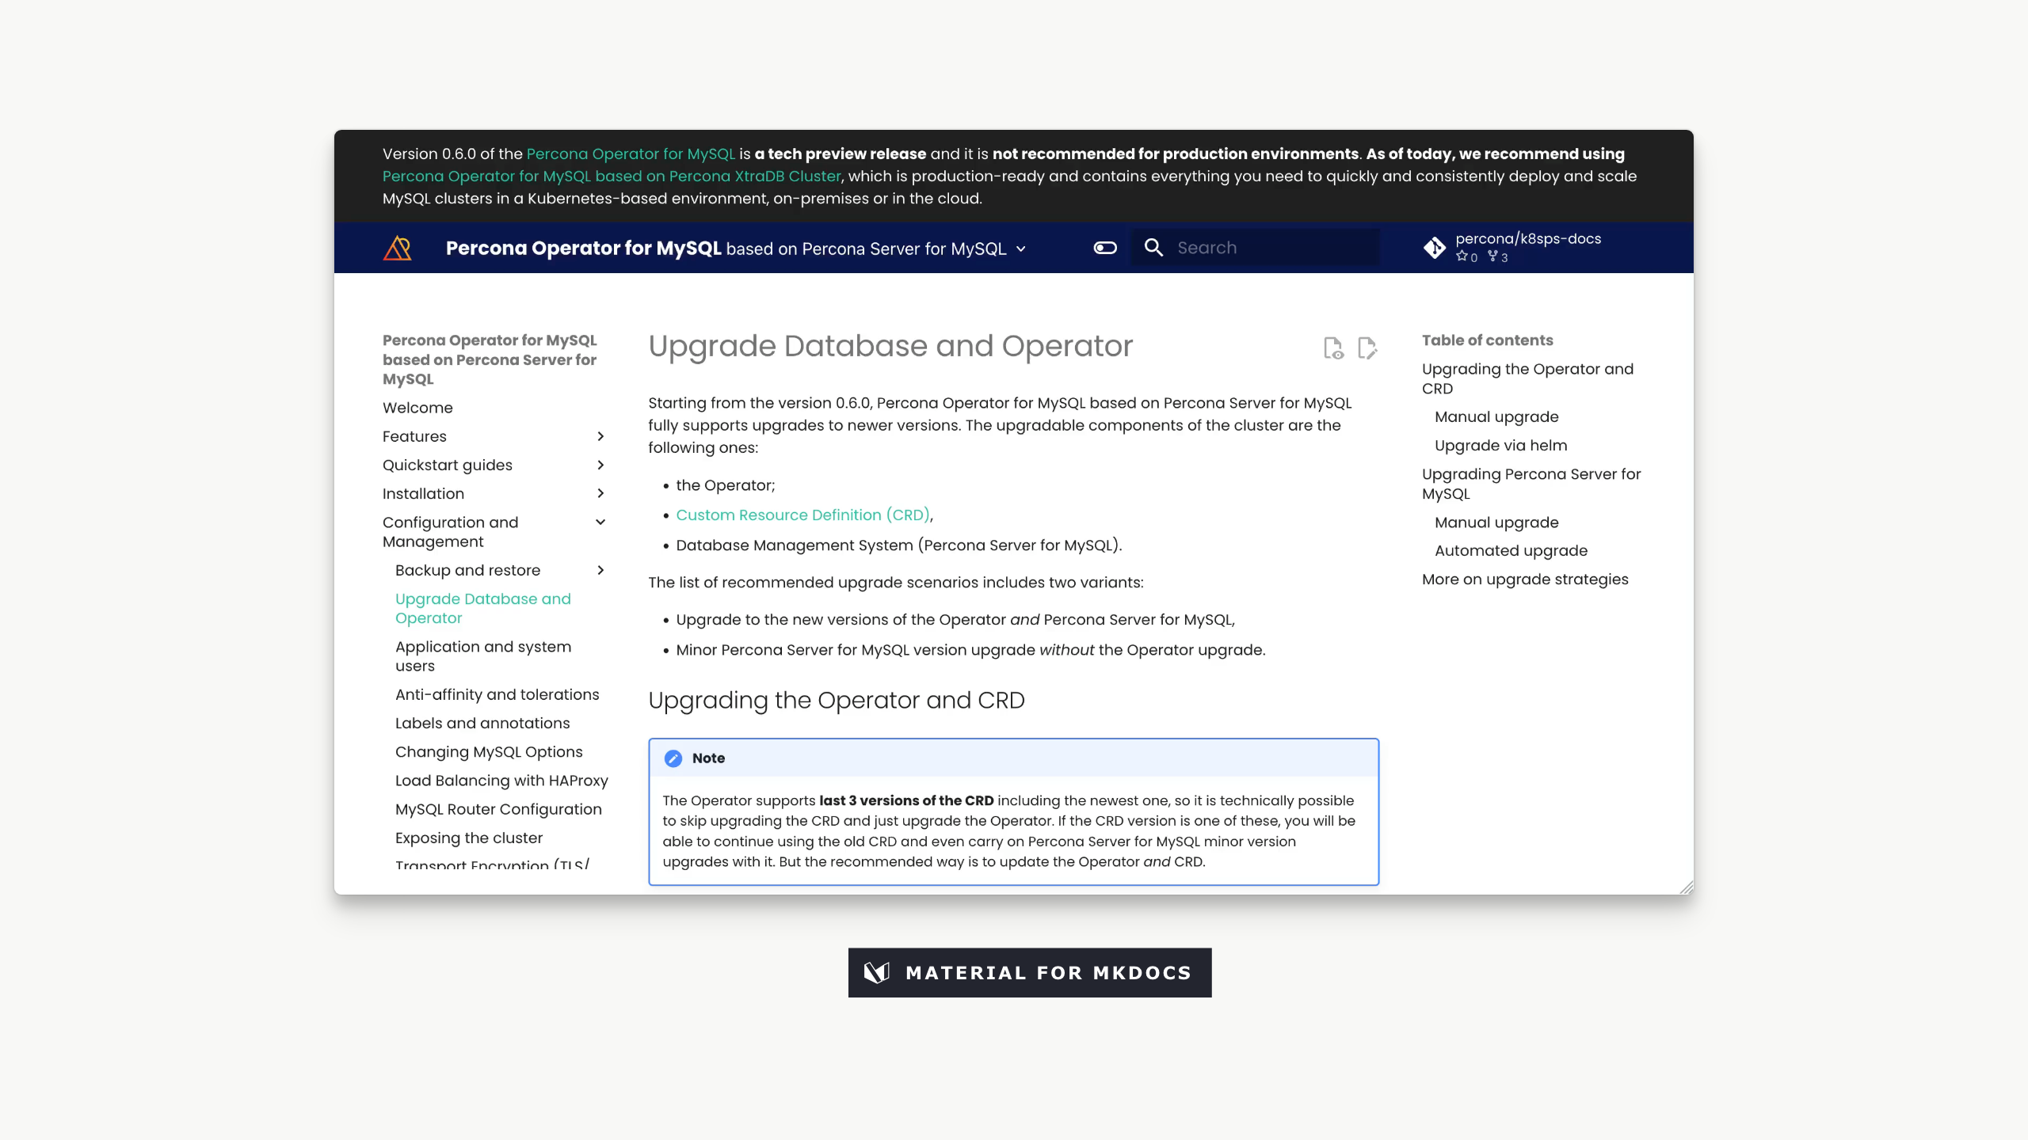
Notes:
![](../img/docs-design/old.gif) <video width="858" height="483" autoplay controls mute loop src="../img/docs-design/old.mp4"></video> In practice, we did: - Audited websites - UX analysis - Identify mistakes - Detect opportunities We had 17x websites like this Built in MkDocs + Material theme - Flexible - Practical - Beautiful theme - Open-source - A lot of alternatives exist - Docusaurus - Vitepress - Starlight - Markdoc - Docsify Alt: Video showing the old website. The particularity here is that is text heavy and dense.

Slide 19
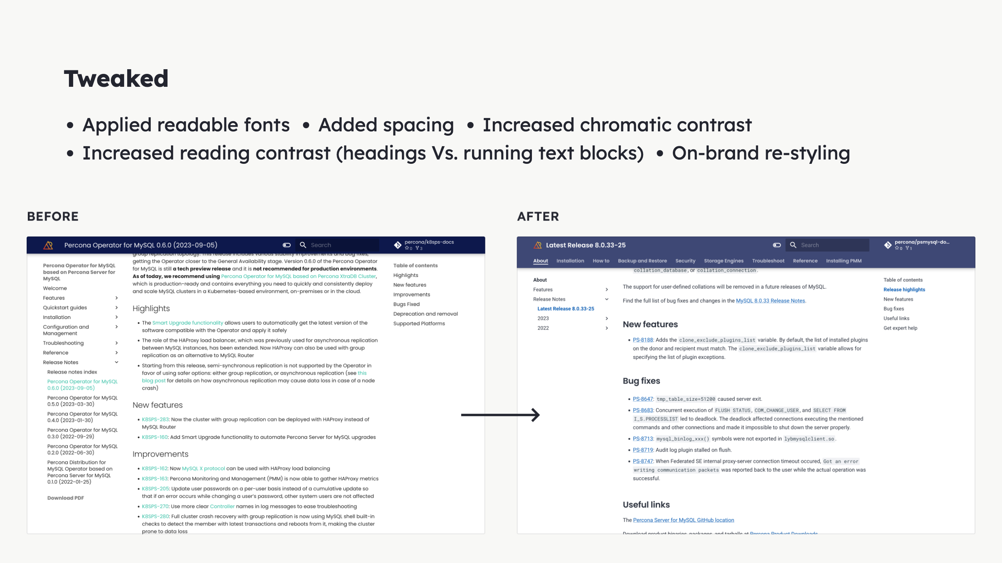
Notes:
Read Alt: Screenshots of documentation websites showing the before and after the tweaking.

Slide 20
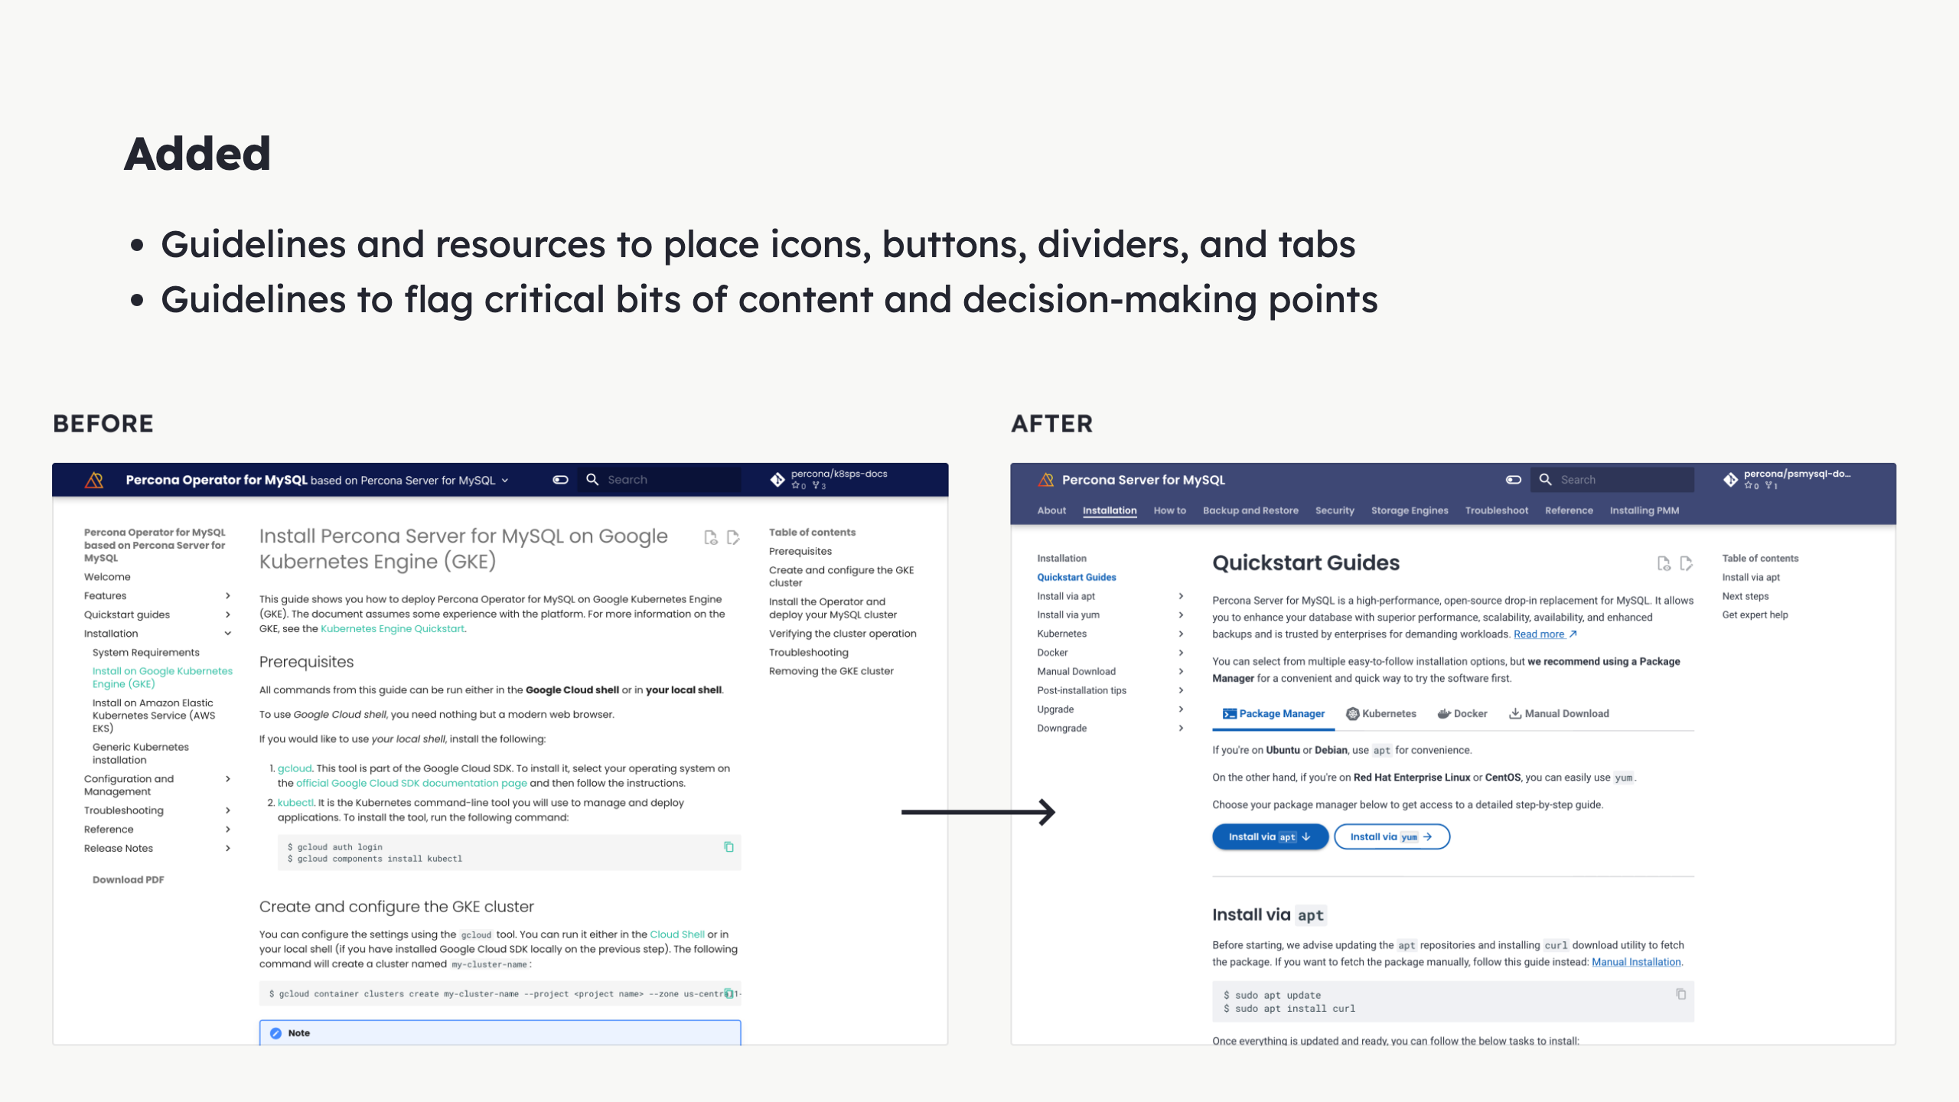
Notes:
Problem: - Not using the full potential - Maintainers: not versed in visual arrangement - UX team open to help Alt: Screenshots of documentation websites showing the before and after adding functionalities.

Slide 21
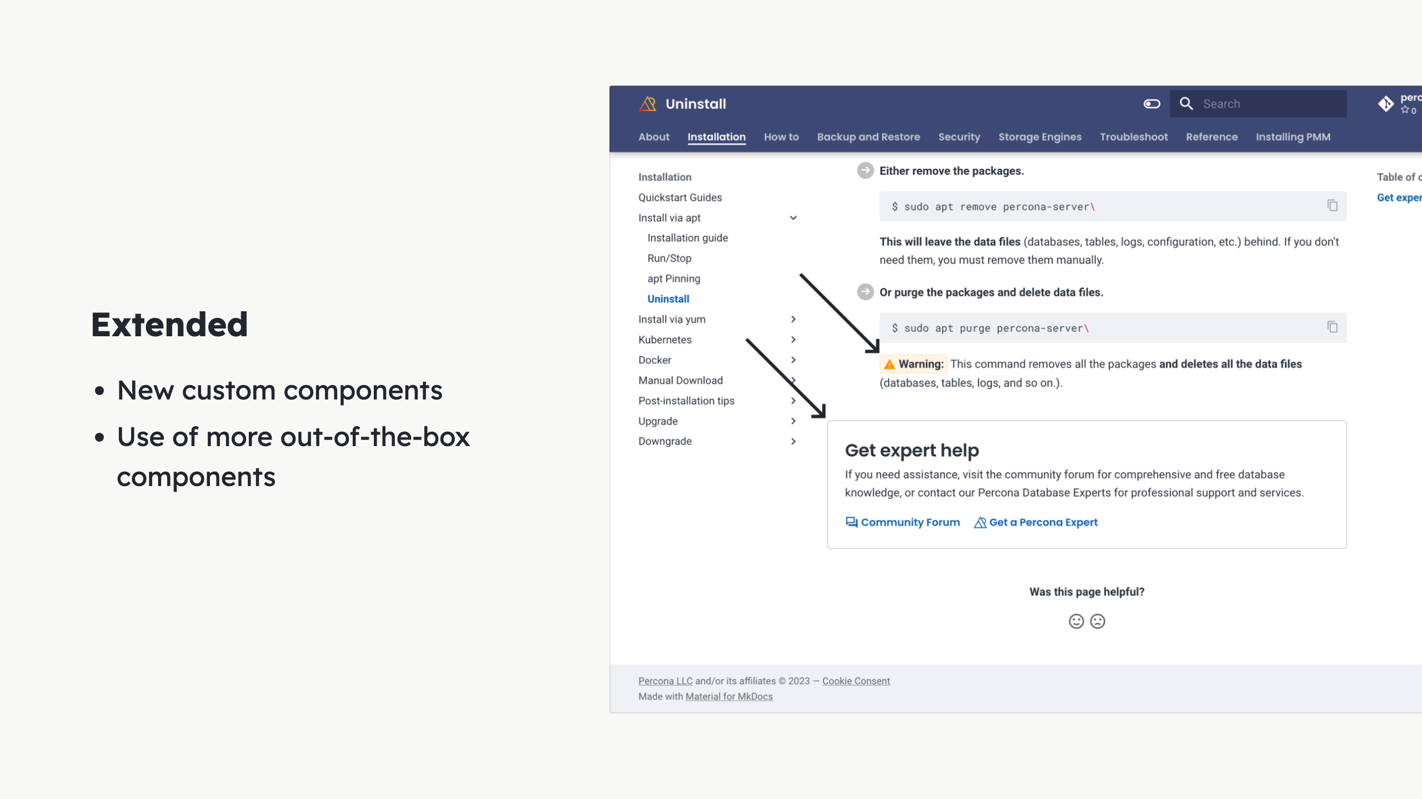
Notes:
MkDocs: - Great out of the box But we wanted more: - New components - Tiny Admonitions - When you want more subtle - Framed Content - When you wish to disrupt - Announce - Shaped out-of-the-box components - Feedback module Alt: Screenshot showing the documentation website page where we added new components.

Slide 22

Notes:
Read

Slide 23
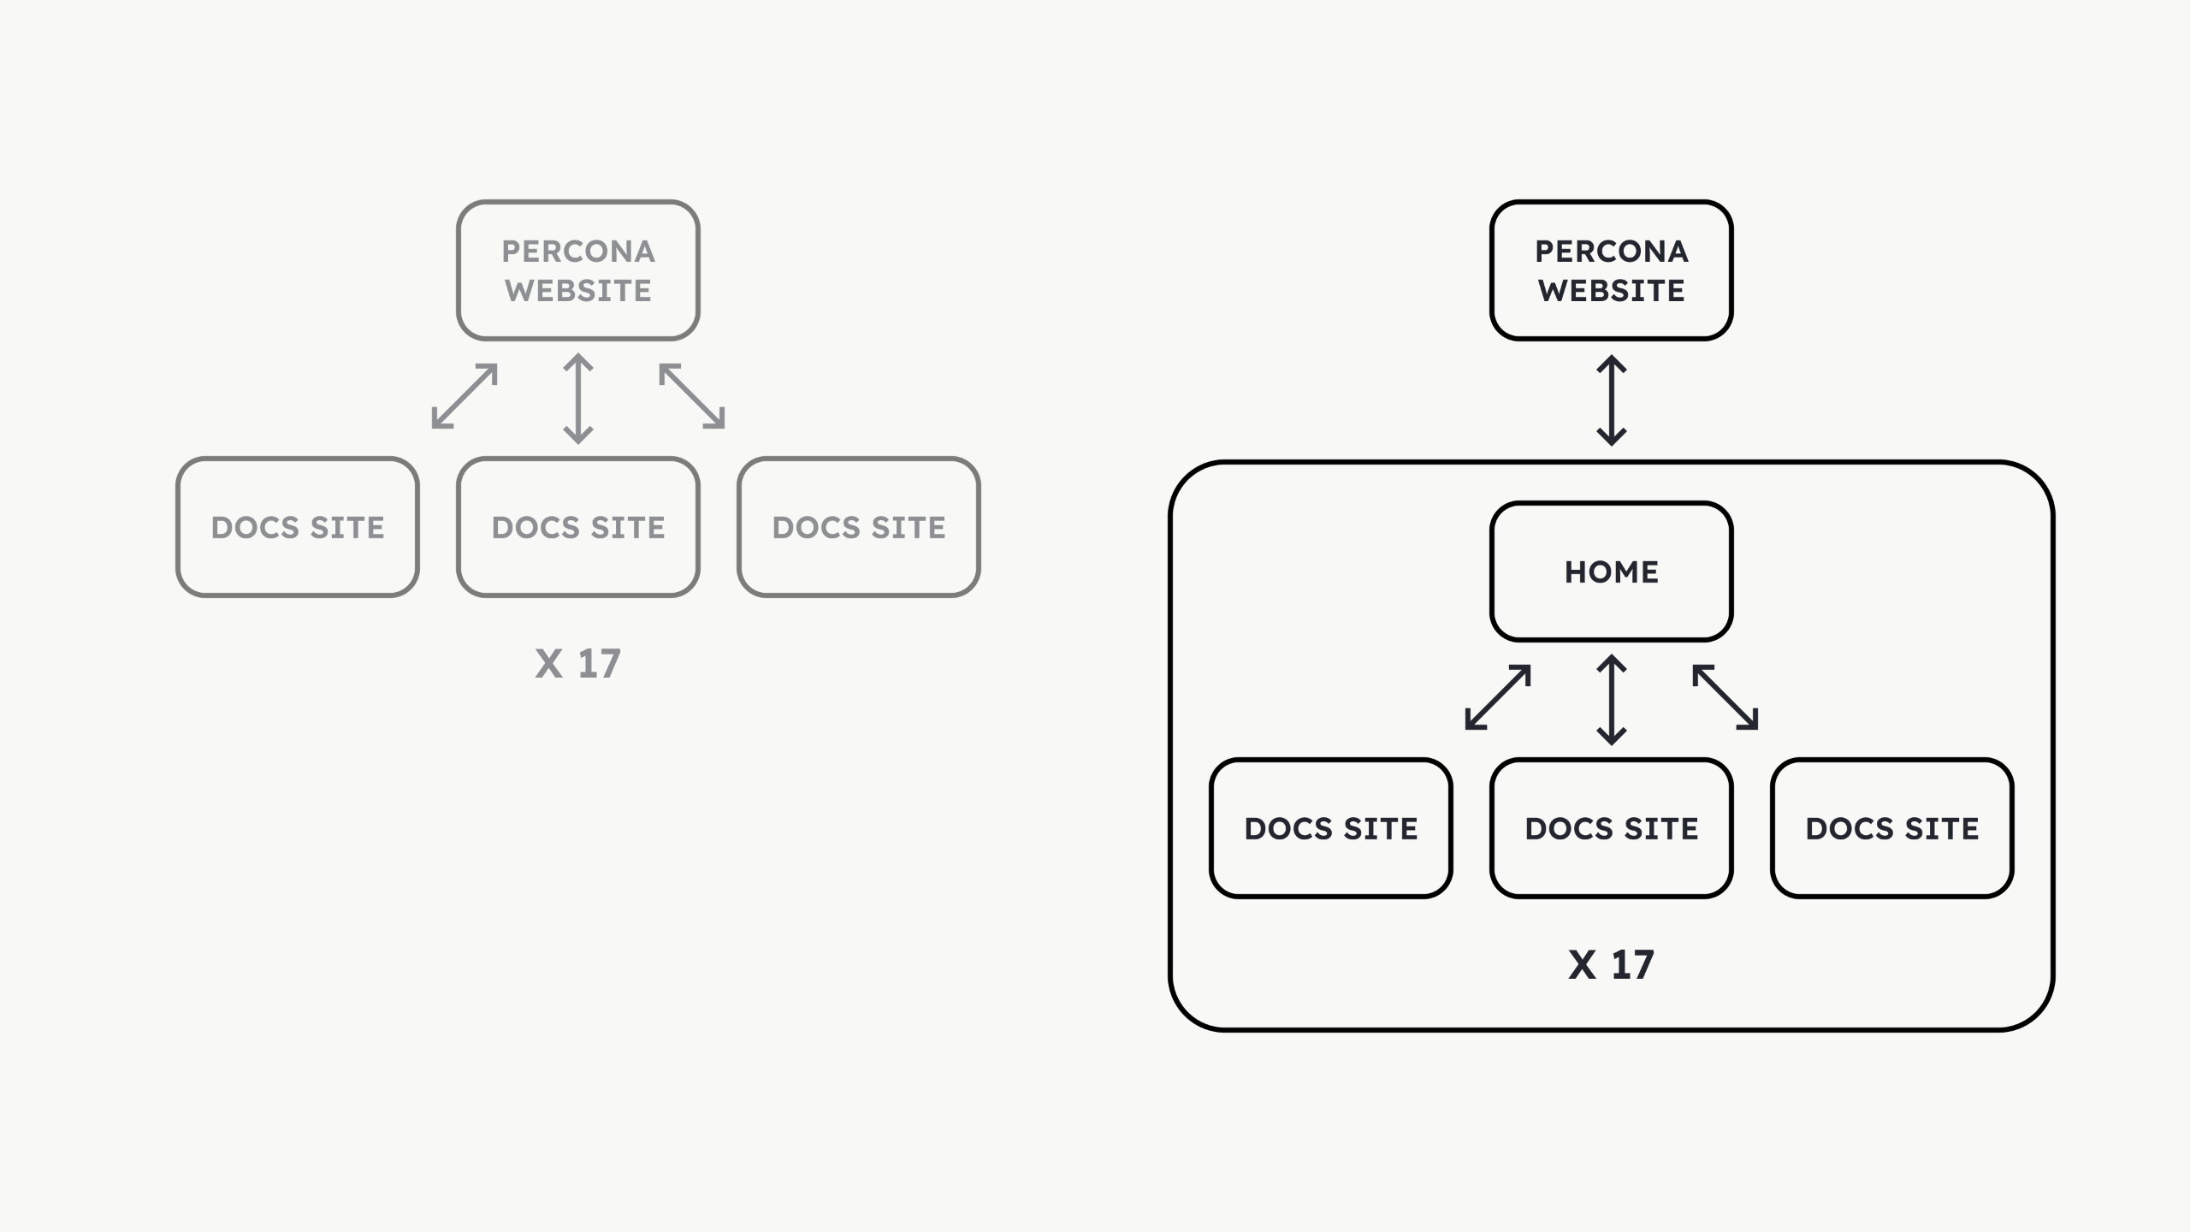
Notes:
Problems: - Documentation left by chance - Disconnected experience - Force user to jump - Main site to docs - Docs to main site - Hard maintenance - 2 places - 2 departments - 2 tech stacks - 2 UX Solution: - Move Docs Home to Docs field - Easy maintenance - 1 ownership - Cohesive experience - Same navigation - Same styling - Feeling of whole Alt: Diagram showing the before and after change we did to unify the experience. The major difference is the creation of a new page called "home", exclusively for the documentation, to help drive users that land anew there.

Slide 24
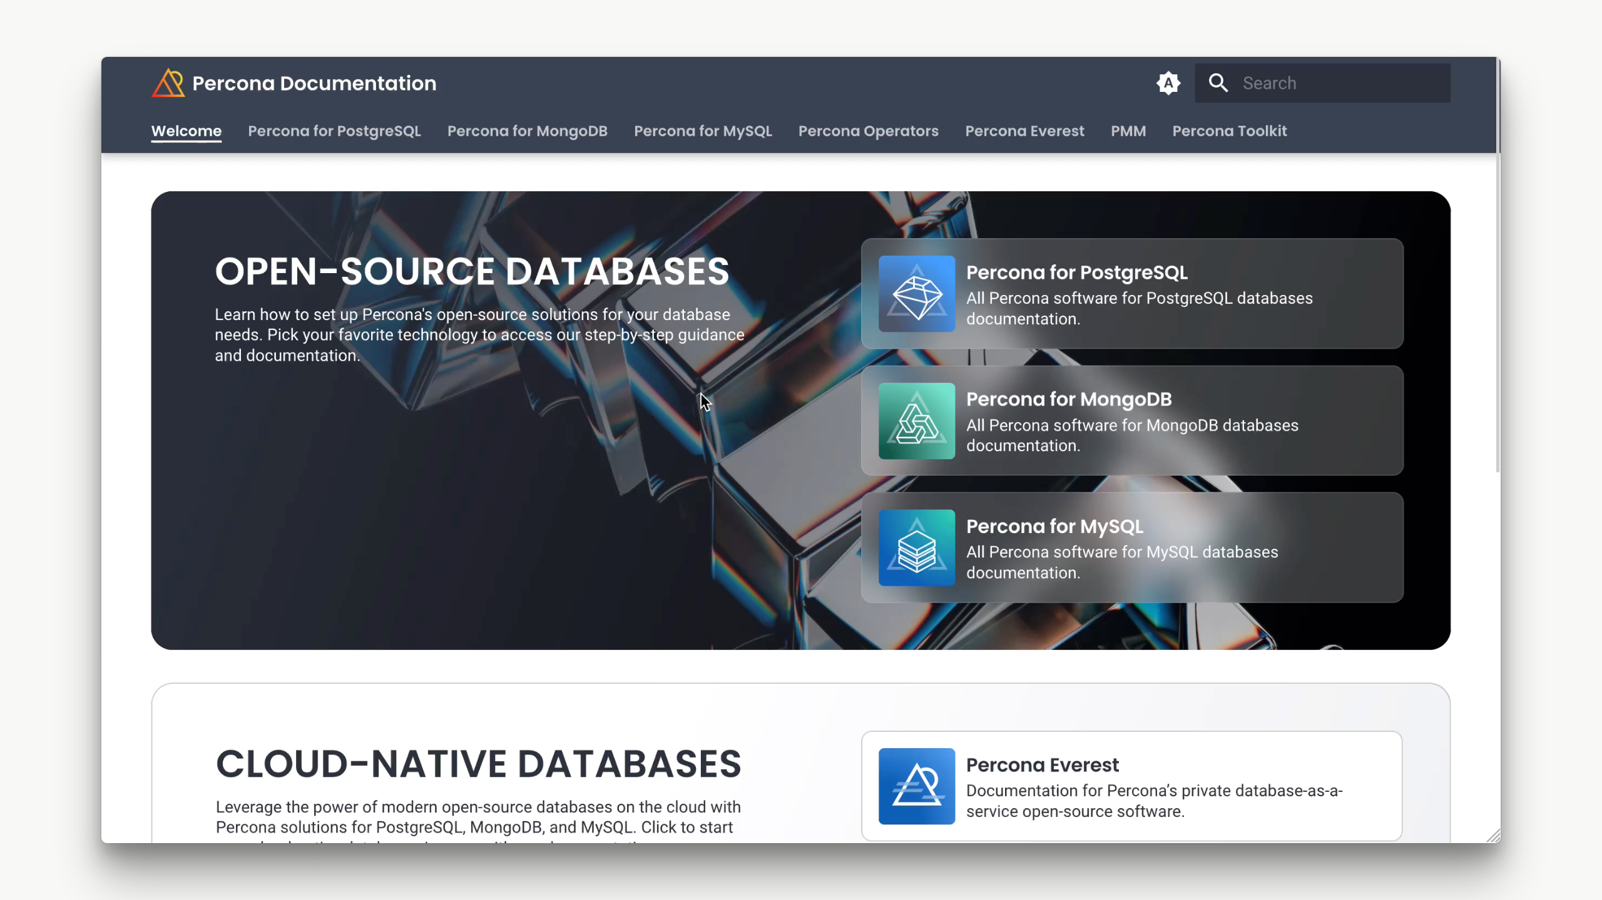
Notes:
![](../img/docs-design/home.gif) <video width="1120" height="630" autoplay controls mute loop src="../img/docs-design/home-long.mp4"></video> - Now you'd be in 1 place only - Docs URL leads to sub docs - Boost aesthetic-usability FX - Perceived professionalism - Perceived functionalism - "Things will work" Alt: Video showing the new version of the documentation website and how it is more clear that every page belongs to the same website.

Slide 25
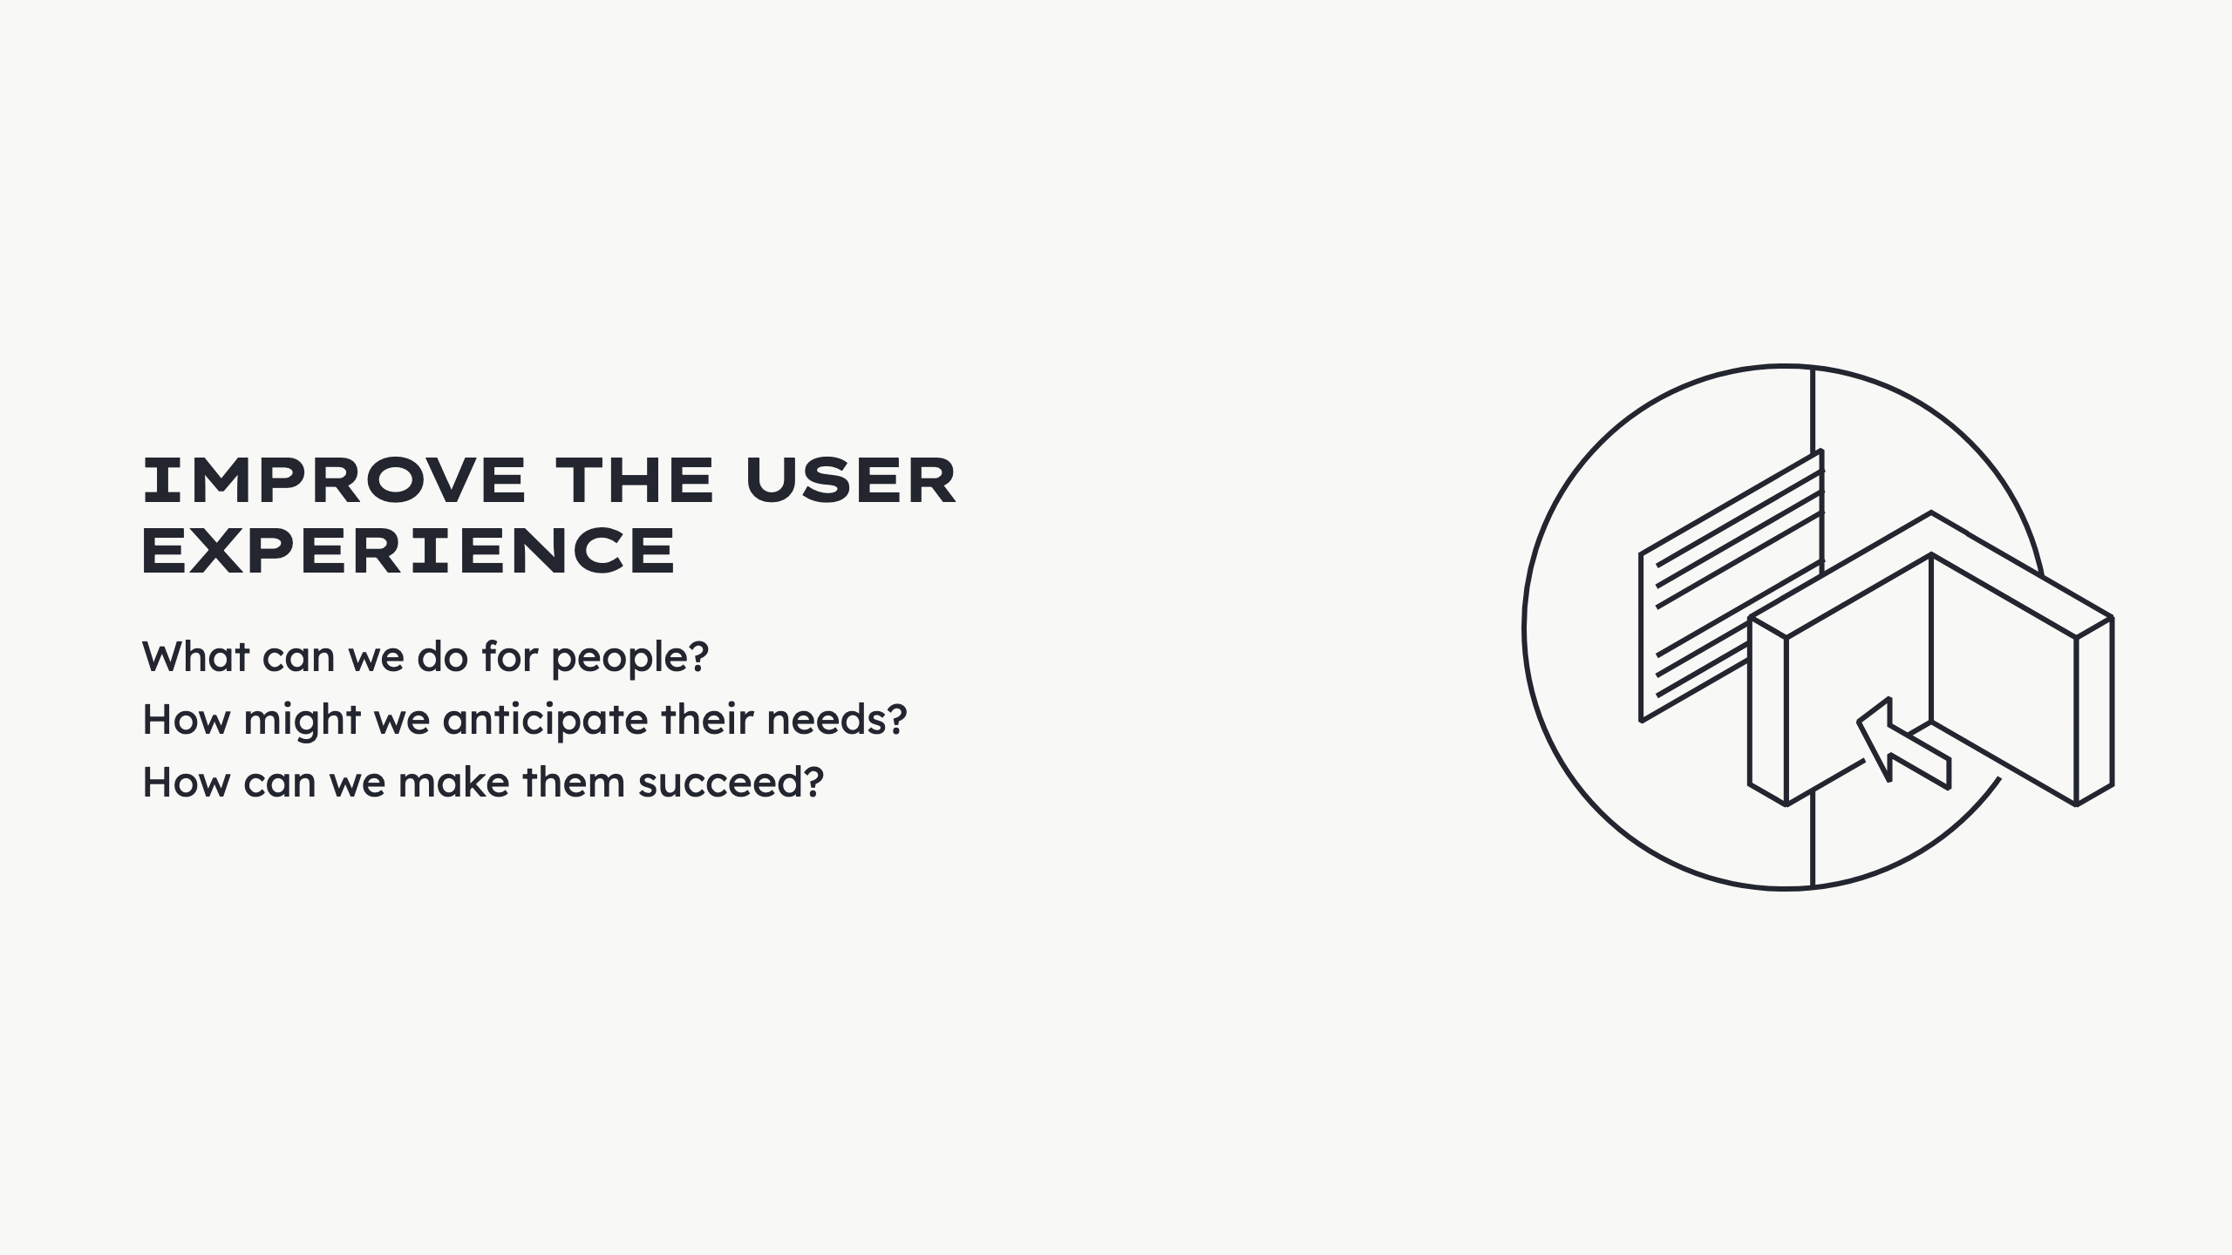
Notes:
We asked... Read Research: - Talked with customers - Talked with experts - Identified problems w/ nav - Garnered the needs

Slide 26

Notes:
- Experimentation - Navigation - Top nav added confusion - In conjuntion w/ side nav - To improve side nav, created guidelines - Make it slimmer - Streamlined - Clearer - Uncluttered - Formed narratives to navigate users - Guides - Quickstart installation - Highlight obvious paths - Lead to the value Alt: Screenshot of the documentation website page where we highlighted the quickstart guides with prominent bullet points.

Slide 27
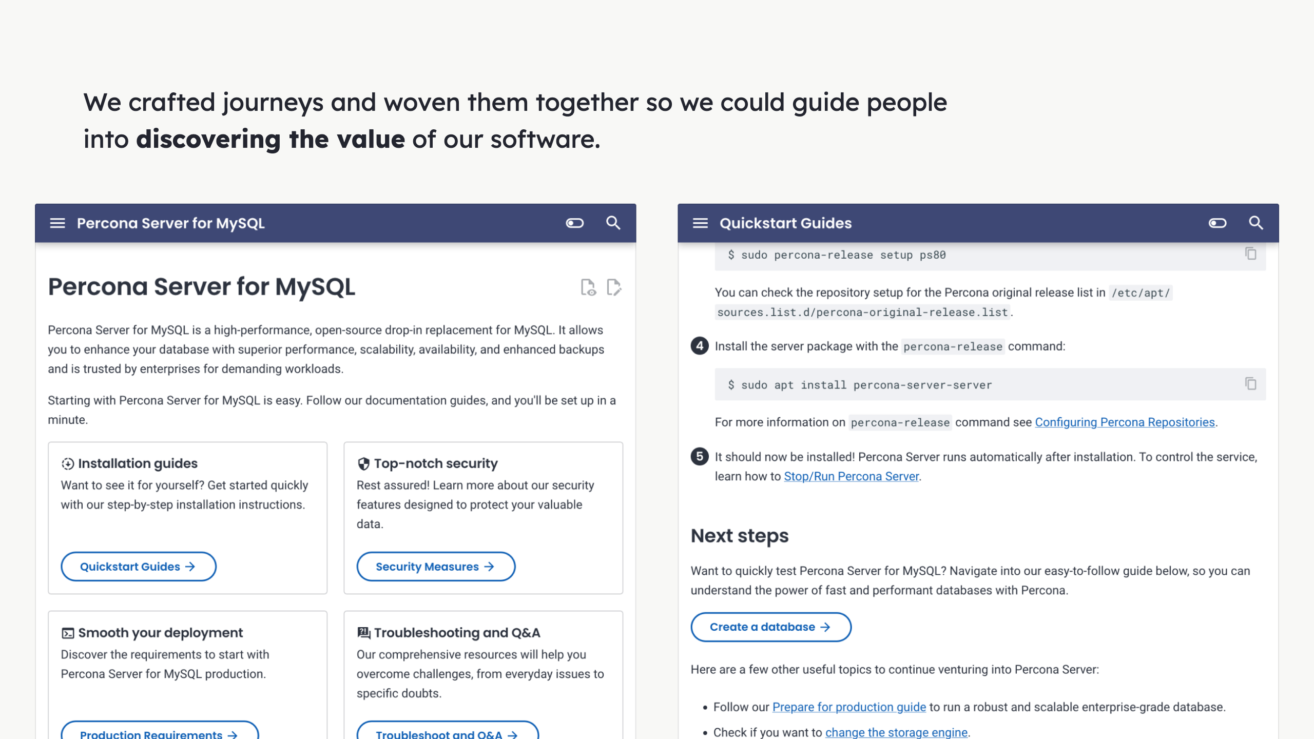
Notes:
- We used visual cues - Apply where needed - Signpost main journeys - While providing alternatives - Avoid roadblock feeling in users Alt: Screenshot of the documentation website pages where we show the use of icons, buttons and other elements to help guide the user.

Slide 28
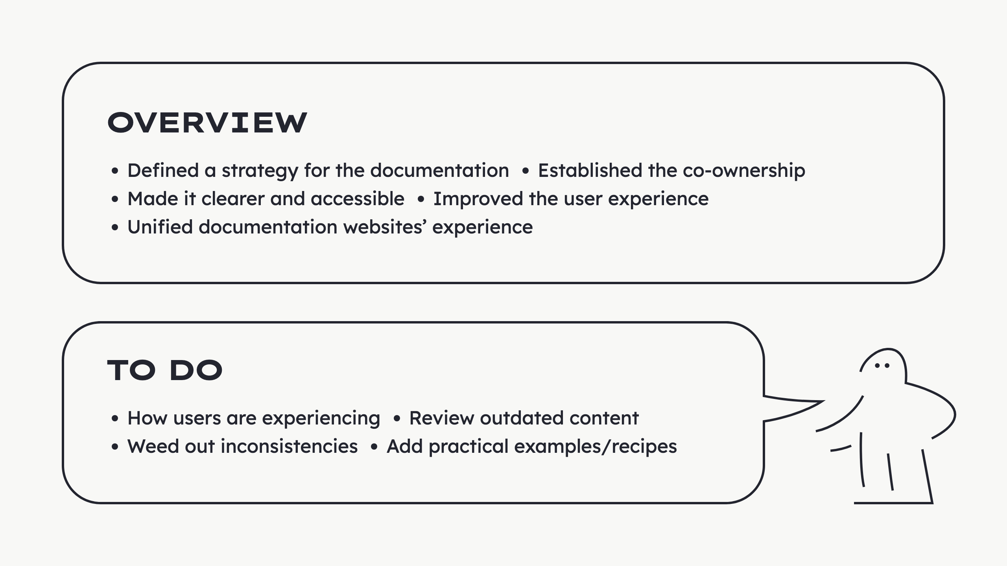
Notes:
Overview: - Defined a strategy - Generate consensus - Value of docs for the team goals - Established the co-ownership - Share responsibility - Garner expertise - Stronger collab - Made it clear and accessible - Readable - Visible - Tweaked to meet needs - Extended to better serve - Improved the user experience - Researched - Experimented - Created guidelines - Highlighted/fixed main journeys - Cross-linking between journeys - Unified documentation websites’ experience - Made it feel whole - Ease navigation - Professional looking To do: - How users are experiencing it - Is it effective? - Do we have more adoption? - Review outdated content - A lot of bloat left - Needs thorough review - Weed out inconsistencies - Make 17 instances closer to each other - Similar - Intuitive - Add practical examples/recipes - People benefit from examples - Create more solutions through time

Slide 29
